Slide 1


The Affordable Care Act
(aka Obamacare):
Yes It Is a Good Thing – Particularly for People with Disabilities!
David Hoff
Board President
APSE
Project Director
Institute for Community Inclusion
UMass Boston

Slide 2
The ACA in Context
The ACA is an improvement but…
of the world’s developed countries, U.S. is still one of the only countries without universal coverage
At 17.6% of GDP, U.S. healthcare spending is
1 ½ times higher than any other country
Average per capita spending on health care:
  U.S.: $8,508
  OECD - 34 countries: $3,322

Slide 3
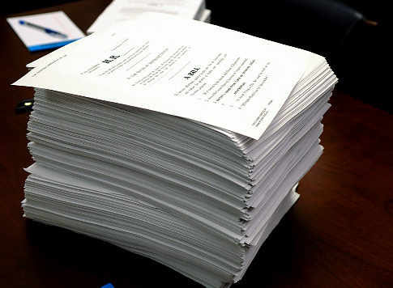
ACA: The Law
Comprehensive & complicated
Media focus: primarily on important but small portions of the law
ACA established both new requirements and programs, while also expanding existing programs
Today’s webinar: focus on aspects with greatest impact on people with disabilities

Slide 4

The ACA
Bottom Line:
Increased health care coverage for
all Americans
Easier and better access to health care coverage
Major increases in health care coverage options
Major increases in individual rights to obtain and maintain coverage

Slide 5
ACA and People with Disabilities
People with disabilities will be healthier
Reduced fear of loss of health care coverage when going to work
Increased options for supports and services to be successfully employed

Slide 6


The Affordable Care Act and People with Disabilities

Slide 7
Unless otherwise indicated, all aspects of the law discussed during the webinar are either in effect or go into effect by January 1, 2014

Slide 8
ACA HIGHLIGHT # 1:
Under the ACA, individuals no longer need to be concerned about loss of coverage due to chronic health conditions or high health care costs

Slide 9
No more annual or lifetime limits on benefits
Coverage cannot be denied due to preexisting conditions or health status
Renewability of coverage is guaranteed and coverage cannot be rescinded
Insurer must offer coverage to everyone who applies; eligibility rules based on health status are not allowed
Maximum of 90 day waiting period to receive coverage
Insurers required to have internal & external appeal process

Slide 10
ACA HIGHLIGHT # 2:
Mandatory Coverage Requirement

Slide 11
Individual Mandate
March 31, 2014: All residents of U.S. required to maintain minimum essential health care coverage
Failure to maintain coverage will result in a financial penalty
Exemptions:
  Taxpayers with income below filing threshold ($10,000 for an individual)
  Members of Indian tribes
  Hardship waiver - premiums exceed 8% of income

Slide 12
Employer Requirements
Employers required to notify workers about health insurance exchanges
January 2, 2015: Employers with 50 or more full-time employees (FTEs) are required to provide affordable coverage or pay a penalty of $2,000 to $3,000 per employee

Slide 13
ACA HIGHLIGHT # 3:
Expanded availability of health care coverage under the ACA

Slide 14

Health Insurance Exchanges:
Who They ‘re For
People without health insurance
Individuals who might qualify for financial assistance (subsidies or tax credits)
Owners of small businesses
People who buy their own insurance

Slide 15
Health Insurance Exchanges
Individuals and businesses can compare and purchase health care coverage via state
Health Insurance Exchanges
17 states operate their own health care exchange marketplaces; remainder are run by federal government
Health insurance exchanges provide access to both private insurance and Medicaid/CHIP
Open enrollment through March 31, 2014
Future years: enrollment is Nov. 15 to Jan. 15
All health insurance exchanges can be accessed via healthcare.gov

Slide 16
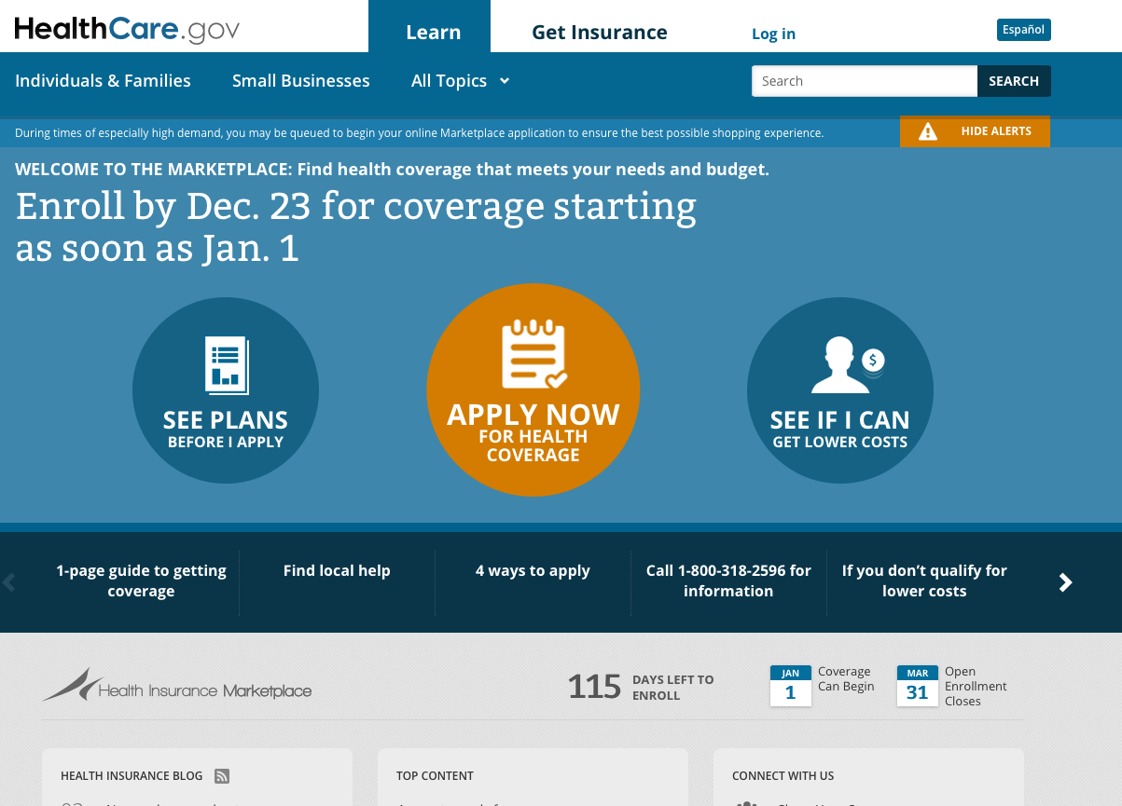

Slide 17
Health Insurance Exchanges:
By the Numbers - Latest Data
State-based marketplaces:
  217,000 have selected a marketplace plan
  384,000 have been determined eligible for Medicaid/CHIP
Federally-operated marketplaces:
  27,000 have selected a marketplace plan
  183,000 have been determined eligible for Medicaid/CHIP
Source: Kaiser Family Foundation

Slide 18

Expansion of Dependent Coverage
All plans offering dependent coverage are required to allow children to remain on their parents’ health insurance until age 26

Slide 19

Expanded Availability of Medicaid
States have option of expanding Medicaid to individuals at 133% of federal poverty level ($15,282 for family of one)

Slide 20
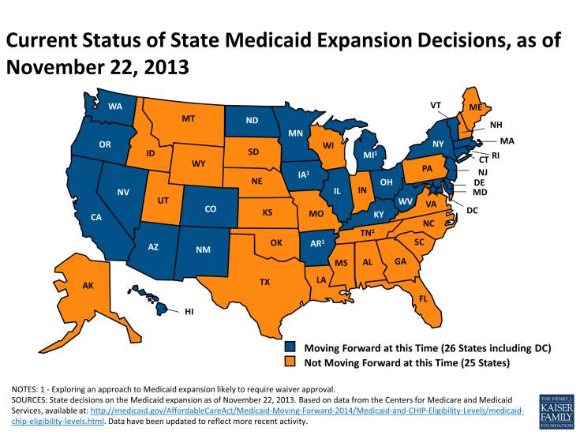

Slide 21
ACA HIGHLIGHT # 4:
Essential Benefit Requirements

Slide 22
Health plans offered in individual and small group markets are required to offer a comprehensive package of benefits

Slide 23
Essential Benefits Required
Outpatient care
Emergency care
Inpatient hospital care
Prenatal and newborn care
Mental health and substance abuse treatment
Prescription drugs
Rehabilitative & habilitative services and devices including physical and occupational therapy, speech-language pathology, psychiatric rehabilitation, and more
Lab tests
Preventive services including counseling, screenings and vaccines
Chronic disease management
Pediatric services, including oral and vision care

Slide 24

ACA HIGHLIGHT # 5:
Streamlined Enrollment and Availability of Guidance & Assistance

Slide 25
Streamlined enrollment with single points of access for exchanges, Medicaid & CHIP
Requirements for uniform language in insurance coverage documents
Funding for health insurance consumer information offices
Expansion of Aging and Disability Resource Centers
Navigators to educate the public about health plans and help individuals overcome barriers to health services

Slide 26
ACA HIGHLIGHT # 6:
Expanded long-term support options under the ACA

Slide 27
Community First Choice - 1915(k) - Medicaid state plan option that enables states to provide community-based attendant care services and supports through the Medicaid State Plan
1915(i) Option for Home & Community Based Care - Expanded availability under the ACA for states that participate
Money Follows the Person Rebalancing Demonstration Project, designed to increase use of home and community-based long-term care services, rather than institutional services, extended through September 2016

Slide 28
CLASS - National voluntary insurance program for purchasing community living assistance and support
Put on hold due to inability to develop funding mechanism that would result in program being fiscally viable

Slide 29

ACA HIGHLIGHT # 7:
Strengthened coordination for individuals on both
Medicare and Medicaid

Slide 30
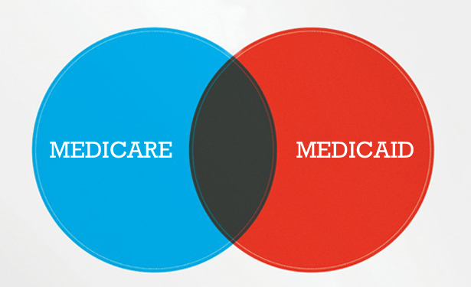
Dual Eligibles Initiatives
Federal Coordinated Health Care Office established to improve coordination for individuals who are dually eligible for both Medicare and Medicaid
15 states undertaking demonstration projects: CA, CO, CT, MA, MI, MN, NY, NC, OK, OR, SC, TN, VT, WA, WI

Slide 31
ACA HIGHLIGHT # 8:
Numerous provisions for strengthening health care workforce

Slide 32

Benefits to People with Disabilities
Strengthens quality of health care workforce to meet their needs
Opportunities to receive training and support for employment in the health care field

Slide 33
ACA Action Steps

Slide 34
ACA Action Steps: Awareness & Education
New rights to coverage, and rights to appeal
Individual mandate requirements
Employer requirements
New coverage options and ways to access
Resources to provide guidance and assistance in understanding health care options, and coordination of health care services
Efforts for coordinated care under Medicare and Medicaid
Current availability of Medicaid long-term support options in your state
Health care workforce development efforts

Slide 35
ACA Action Steps: Advocacy
New rights to coverage are enforced
Dual eligibles - Medicare and Medicaid - improved care, not just cost savings
Medicaid expansion, if state is not participating
Expansion of Medicaid long-term support options
Participation of people with disabilities in health care workforce training
Partnering on on health care workforce development projects and grant applications
Ensure people with disabilities are at the table as decisions are made about ACA implementation

Slide 36
ACA Action Steps: Connecting
Ensure understanding of new health care options by work incentive assistance programs
Ensure linkage with resources and experts (e.g., health care navigators, ADRCs)

Slide 37

Wrap-Up
Separate ACA myth from fact
Use resources to educate yourself and others
Find out what’s happening in your state
Look for and create opportunities to educate, collaborate, and advocate

Slide 38
Handouts
ACA Resource List
Medicaid Long-Term Care Options

Slide 39

Contact Information
David Hoff
617-287-4308
david.hoff@umb.edu
www.communityinclusion.org
www.apse.org

